Slide 1
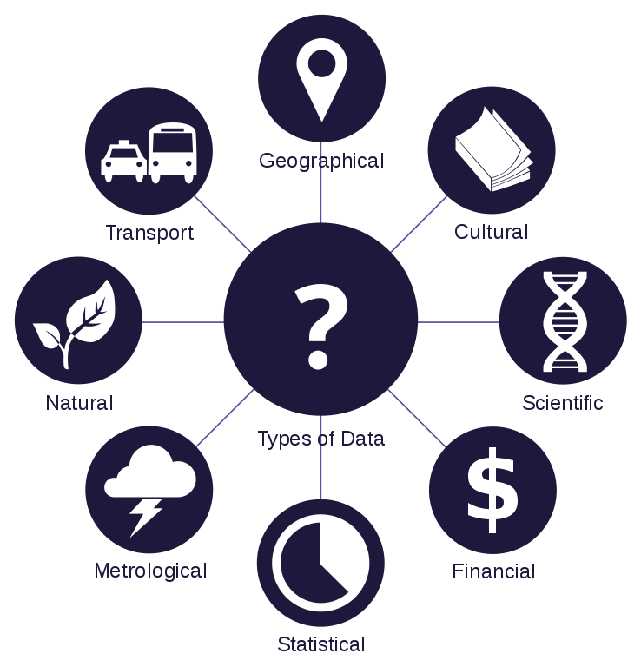

Machine Learning – Basics
Background
Michael Aydinbas
11. Oktober 2020

Slide 2

Michael Aydinbas
IT Consultant, Data Scientist
Data Science, Data Engineering, Big Data
Biographie
Auszug relevante Projekterfahrung
Seit 2019 bei EXXETA in Karlsruhe
MSc. in Psychologie in IT, TU Darmstadt
BSc. in Umwelting.-Wiss. sowie in Psychologie in IT, TU Darmstadt
Forschung
Clustern von hochdimensionalen Zeitreihen mit Unsupervised-, Semi-Supervised- and Active-Learning-Verfahren
Anomaliedetektion und Qualitätssteigerung von Sensornetzwerkdaten
Thesis: Realizing Cognitive User Models for Adaptive Serious Games, TU Darmstadt
Data Engineering & Data Science
Anforderungsanalyse und Entwicklung eines Sequencing-Frameworks zur automatischen Erkennung von Fahrszenen
Entwicklung einer Python Toolbox für Datenexploration/Datenanalyse auf Basis von Apache Spark​
Entwicklung eines konfigurierbaren, robusten, batch-basierten Messdatenkonverters​
Konzeptionierung und Implementierung eines Frameworks zur Erkennung und Korrektur von fehlerhaften Messsignalen sowie zur Erkennung des gefahrenen Prüfzyklus‘
Einsatz von Apache Spark als Analyse-Engine für die Integration sowie Verarbeitung von Messdaten
Entwicklung und Implementierung eines Prognosealgorithmus‘ zur Vorhersage von Prozesszuständen
Erstellung von Tutorials, interaktiver Notebooks und Visualisierungs-Dashboards
App Development
Konzeption, Entwicklung und Deployment mehrerer Prototypen zur Analyse und Visualisierung von Messdaten
Implementierung von Unit-Tests mit Python
Beratungskompetenz
Rollen: IT Consultant, Data Scientist
Consulting Expertise: Forschung und Entwicklung, Automotive, Strategieberatung
Technische Expertise: Data Science, Large-Scale Data Processing, Probabilistische Modelle, Web-Technologien
Sprachen
Englisch
Deutsch

Slide 3
Webinar’s Agenda
Machine Learning Basics
Definition
Relation to other fields
Little terminology
The ML Workflow
Get data
Prepare data
Model selection and training
Model evaluation
Model improvement
Resources

Slide 4
Machine Learning
What comes to your mind?

Slide 5
“Every serious technology company now has an Artificial Intelligence team in place. These companies are investing millions into intelligent systems for situation assessment, prediction analysis, learning-based recognition systems, conversational interfaces, and recommendation engines. Companies such as Google, Facebook, and Amazon aren’t just employing AI, but have made it a central part of their core intellectual property.” - Kristian J. Hammond

Slide 6
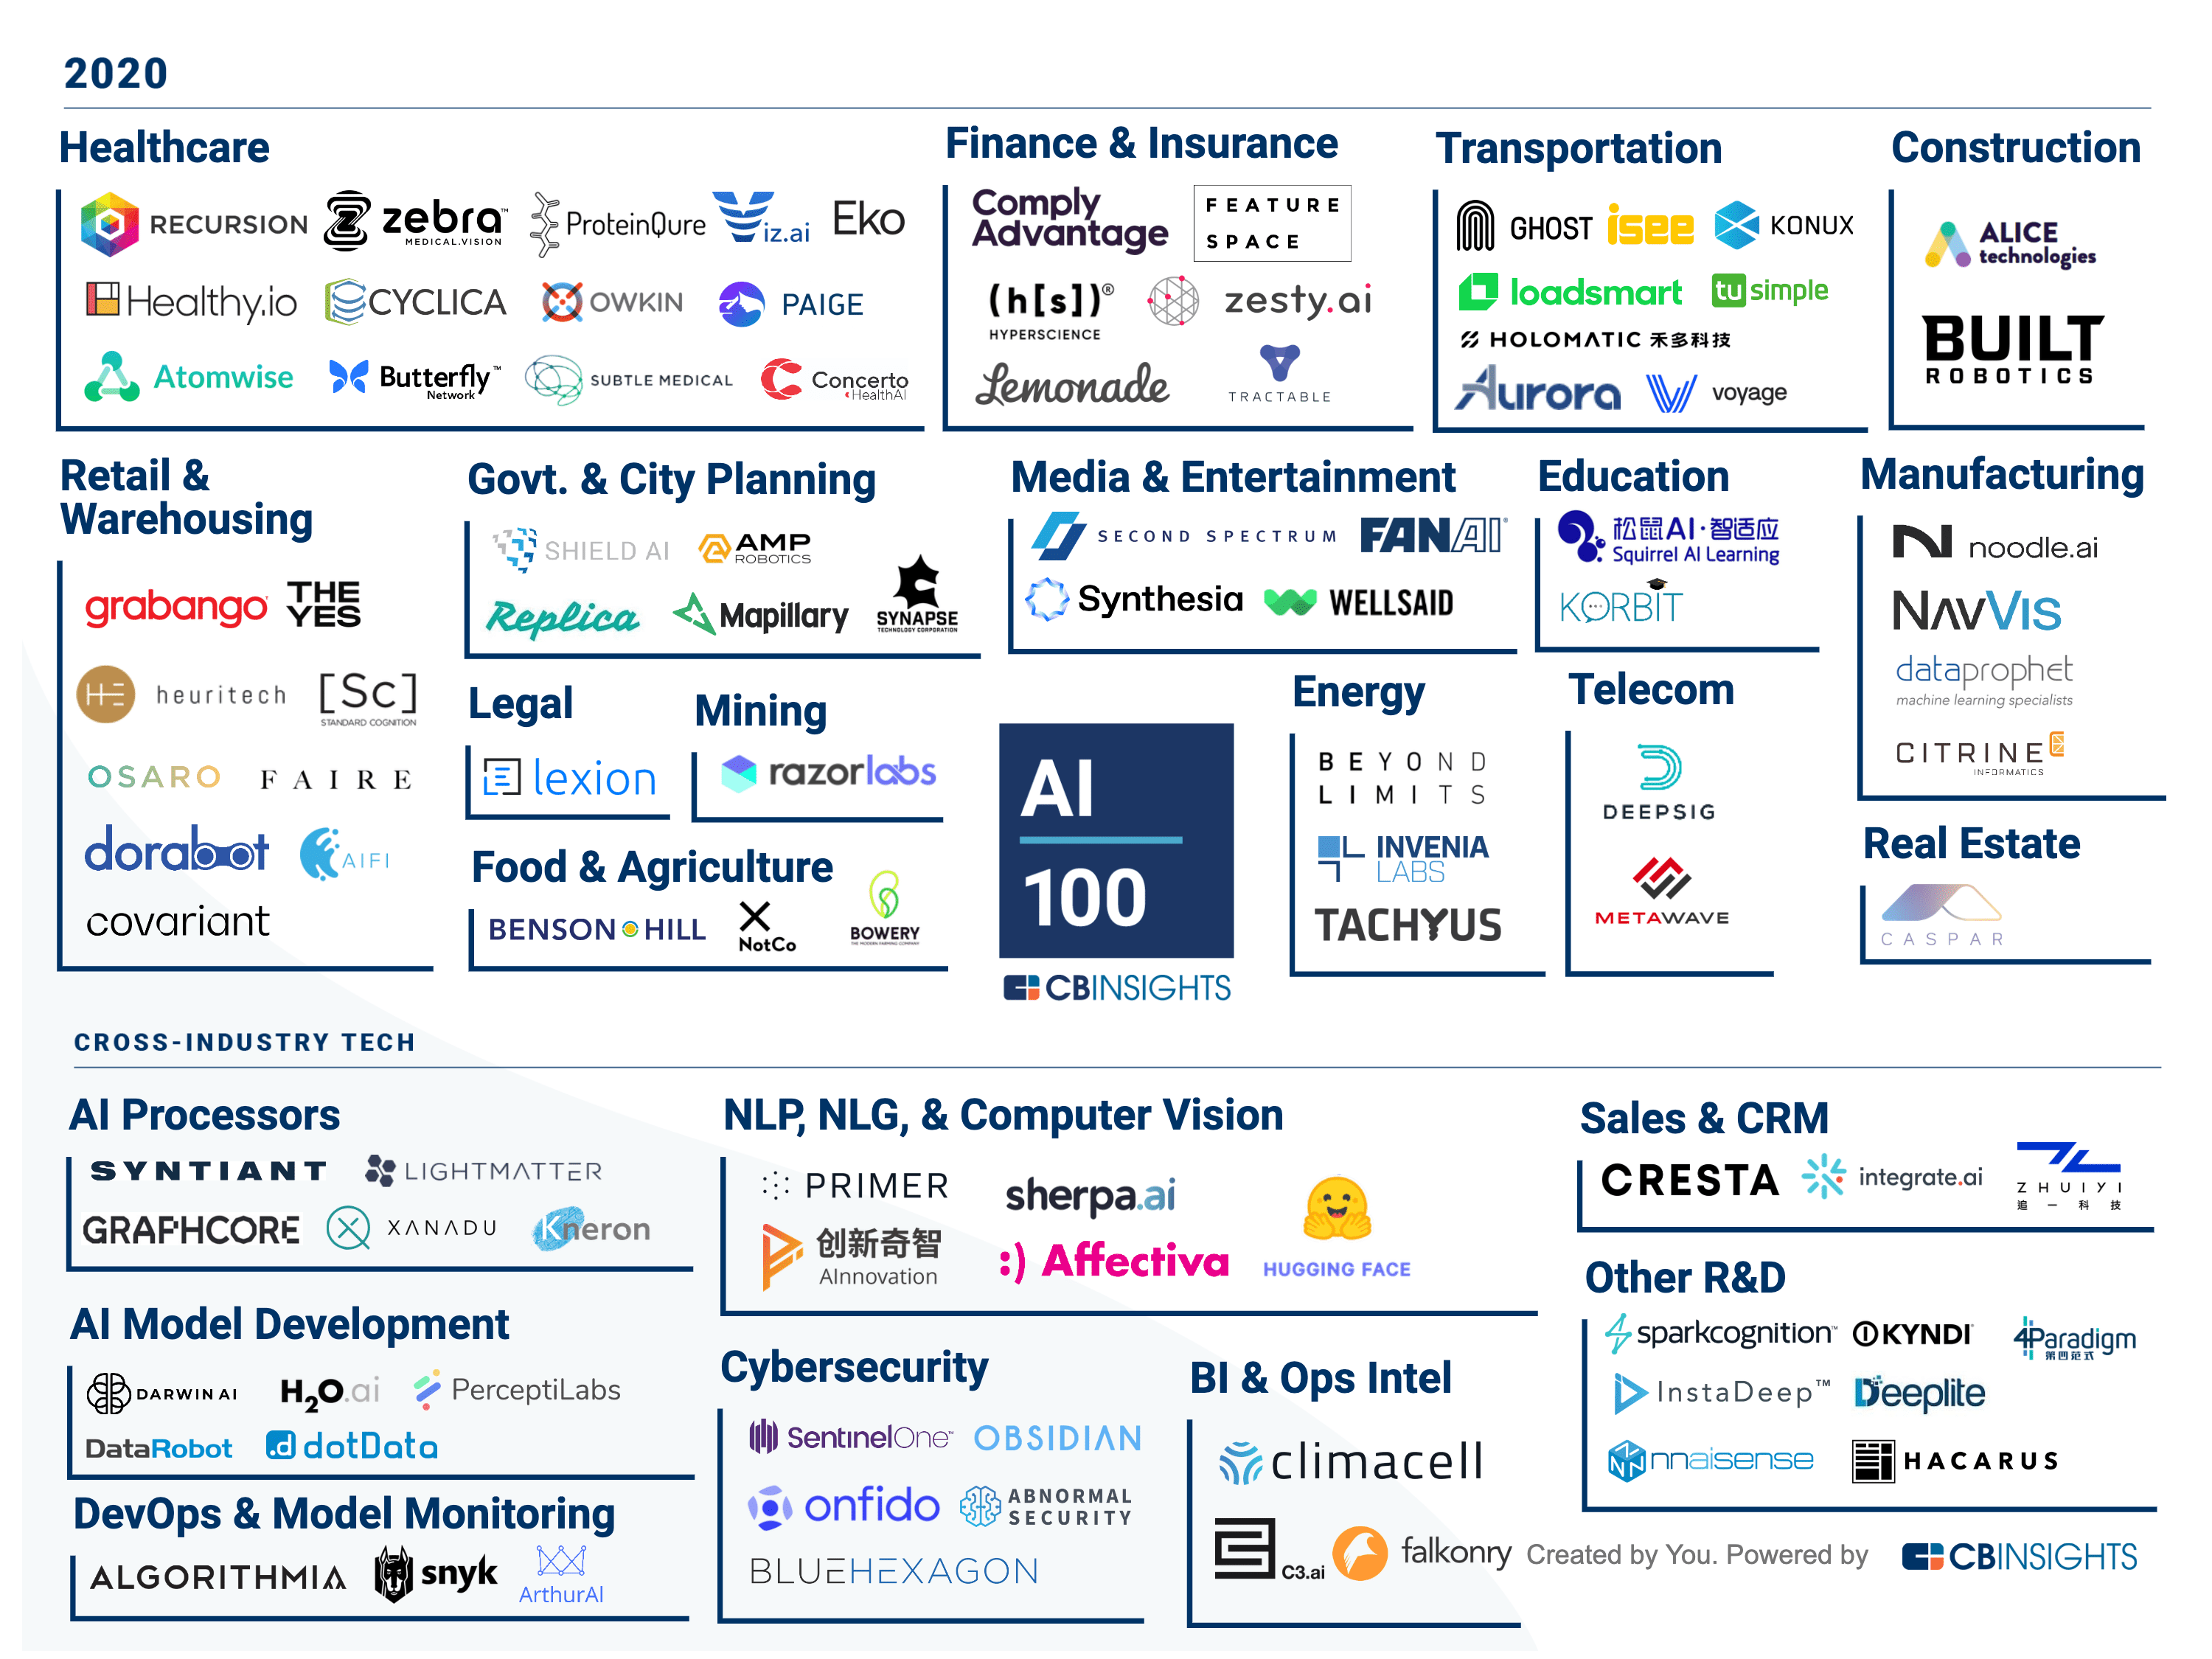
Startups and AI
The AI 100 is CB Insights' annual ranking of the 100 most promising AI startups in the world.
https://www.cbinsights.com/research/artificial-intelligence-top-startups/

Slide 7
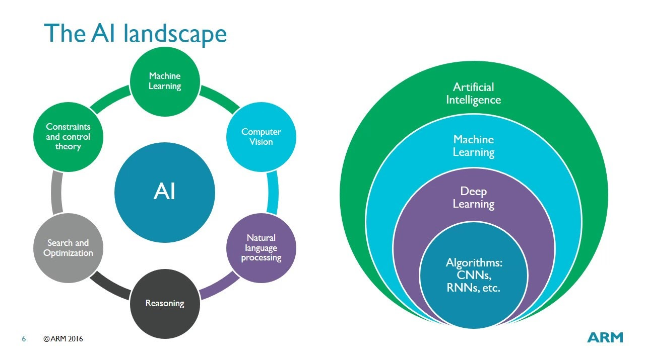
Artificial Intelligence and Machine Learning

Slide 8


What does “learning” mean?
https://youtu.be/f_uwKZIAeM0
Notes:
Mein Anliegen ist es nicht, über das Für und Wieder von Künstlicher Intelligenz oder ML zu reden. Es ist ein Tool, eine Technologie und kann wie jede andere Technologie für beliebige Zwecke, moralische wie amoralische eingesetzt werden. Es scheint nur so, dass ML eben eine grundlegende Veränderung in allen Bereichen über kurz oder lang bewirken wird, und daher sollte sich jeder mit den ethischen Fragen, die diese Entwicklung mit sich bringt, befassen. Ich bitte all meine Aussagen daher als neutral aufzufassen, ich stelle die Technologie vor, aber ich bewerte sie nicht.

Slide 9
What does “learning” mean?
“Machine learning is the science of getting computers to act without being explicitly programmed.” – Andrew Ng, Stanford University (based on Arthur Samuel, 1959)
“Machine learning algorithms can figure out how to perform important tasks by generalizing from examples.” – University of Washington
“A computer program is said to learn from experience E with respect to some class of tasks T and performance measure P, if its performance at tasks in T, as measured by P, improves with experience E.” – Tom Mitchell

Slide 10
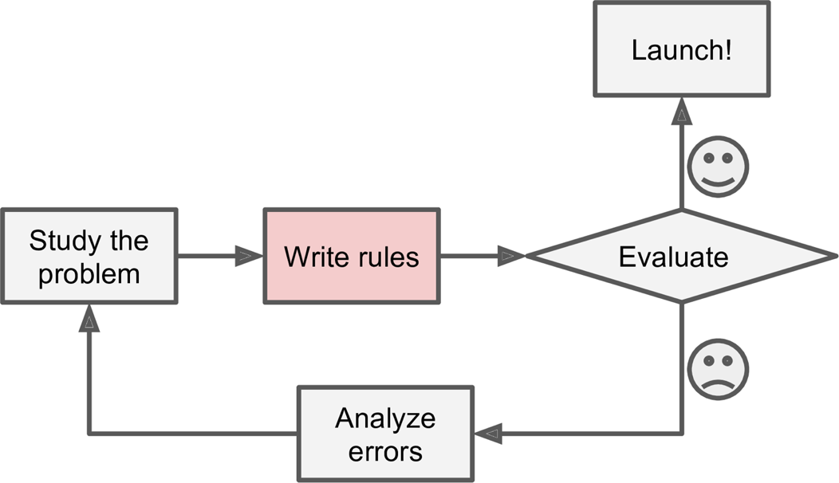
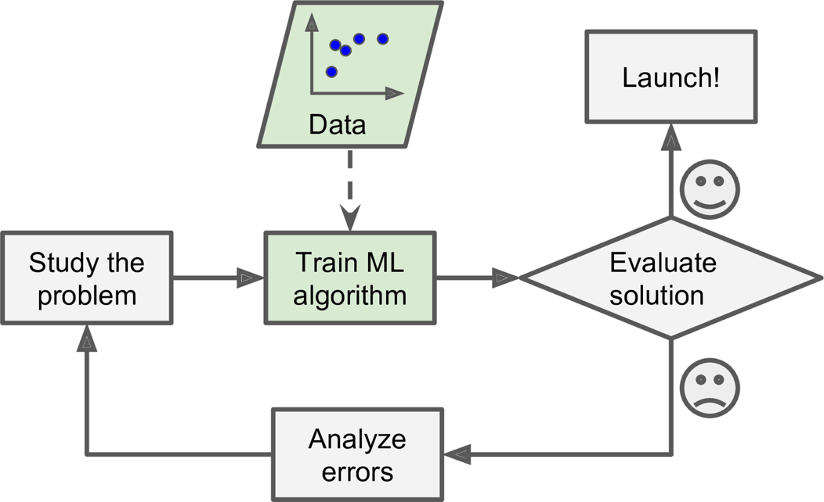
Why Use Machine Learning?
How would you implement a spam filter?
Aurélien Géron (2017), Hands-On Machine Learning with Scikit-Learn and TensorFlow, Publisher: O'Reilly Media, Inc., ISBN: 9781491962299
Notes:
To summarize, Machine Learning is great for:
- Problems for which existing solutions require a lot of hand-tuning or long lists of rules: one Machine Learning algorithm can often simplify code and perform better.
- Complex problems for which there is no good solution at all using a traditional approach: the best Machine Learning techniques can find a solution.
- Fluctuating environments: a Machine Learning system can adapt to new data.
- Getting insights about complex problems and large amounts of data.

Slide 11
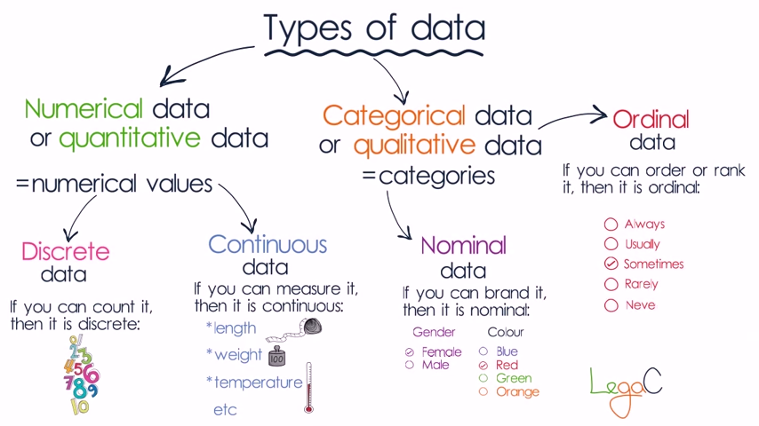
What does our “data” look like?

Slide 12
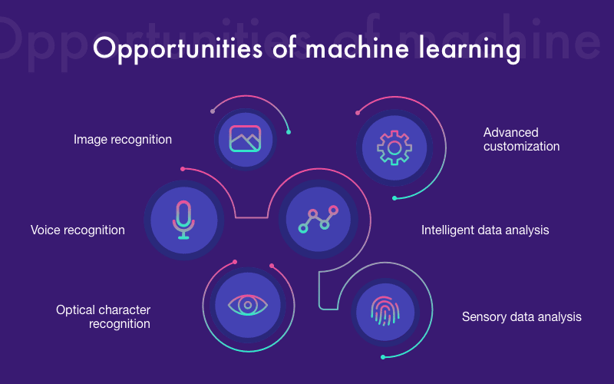
What does our “data” look like?

Slide 13
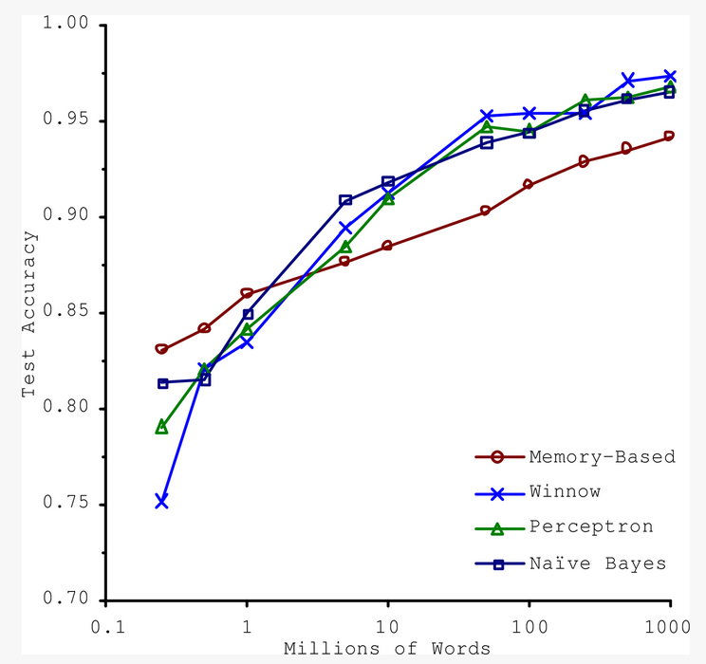
Main challenges of Machine Learning
Insufficient Quantity of Training Data
Nonrepresentative Training Data
Poor-Quality Data
Irrelevant Features
Overfitting the Training Data
Underfitting the Training Data
Michele Banko and Eric Brill. 2001. Scaling to very very large corpora for natural language disambiguation. In Proceedings of the 39th Annual Meeting on Association for Computational Linguistics (ACL '01). Association for Computational Linguistics, USA, 26–33. DOI:https://doi.org/10.3115/1073012.1073017

Slide 14
Machine Learning Workflow

Slide 15

The Machine Learning workflow - simplified
https://www.freecodecamp.org/news/every-single-machine-learning-course-on-the-internet-ranked-by-your-reviews-3c4a7b8026c0/

Slide 16

The bigger picture – CRISP-DM
https://en.wikipedia.org/wiki/Cross-industry_standard_process_for_data_mining
Notes:
Cross-industry standard process for data mining, known as CRISP-DM,^{[1]} is an open standard process model that describes common approaches used by data mining experts. It is the most widely-used analytics model.^{[2]}

Slide 17
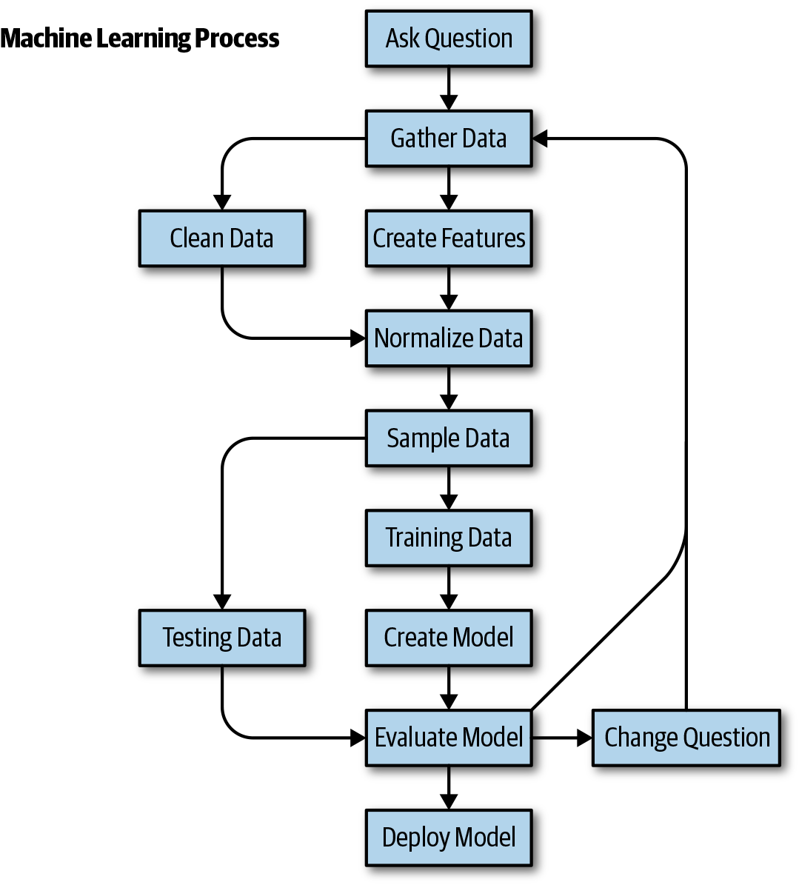
A more detailed workflow
Machine Learning Pocket Reference by Matt Harrison

Slide 18
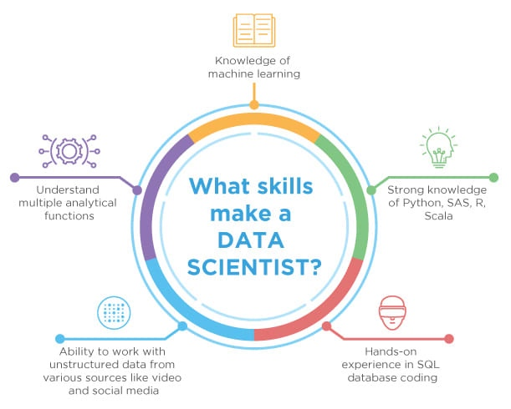
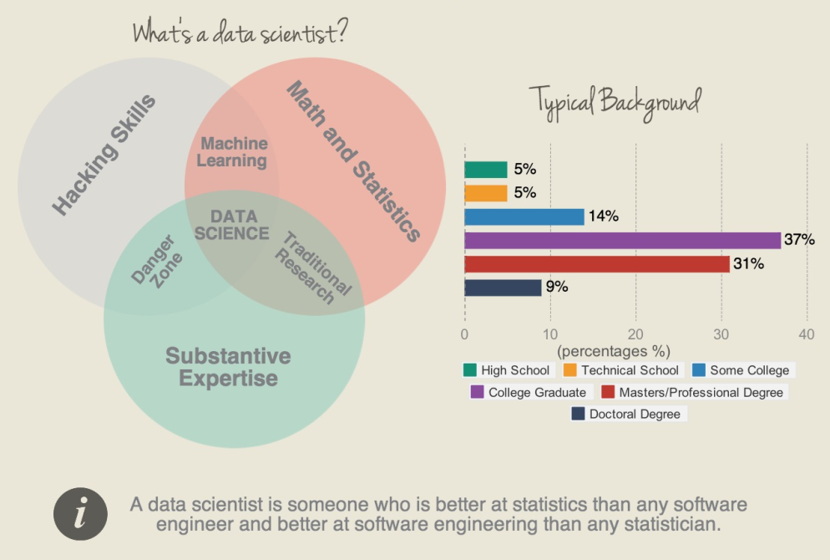
The bigger picture – skillset of a data scientist
https://www.simplilearn.com/data-science-vs-data-analytics-vs-machine-learning-article
https://machinelearningmastery.com/become-data-scientist/
Notes:
The main difference between the two is that data science as a broader term not only focuses on algorithms and statistics but also takes care of the entire data processing methodology.

Slide 19
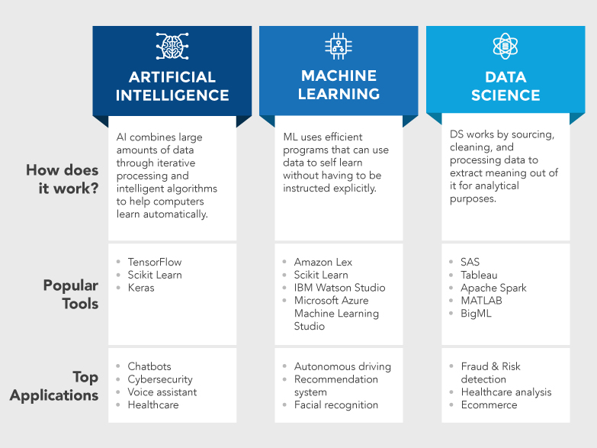
The bigger picture – AI vs ML vs DS
https://www.mygreatlearning.com/blog/difference-data-science-machine-learning-ai/
Notes:
The main difference between the two is that data science as a broader term not only focuses on algorithms and statistics but also takes care of the entire data processing methodology.

Slide 20
The Machine Learning workflow - simplified

Slide 21
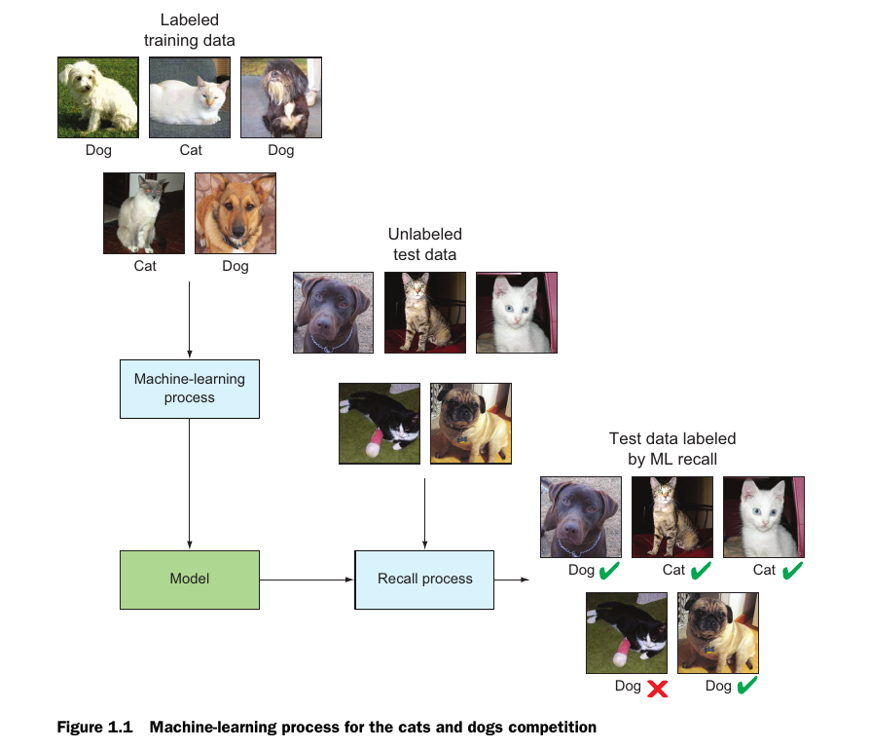
The Machine Learning workflow - example
Any error is a valuable information by itself!
Henrik Brink, Joseph W. Richards, and Mark Fetherolf , Real-World Machine Learning, Manning, September 2016, ISBN 9781617291920

Slide 22

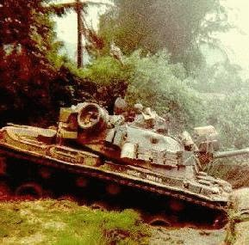


Why you should care about your data set
Detecting tanks
US Army wanted to use Neural Networks to detect tanks hidden behind trees
However...something went wrong
https://neil.fraser.name/writing/tank/

Slide 23
Get Data

Slide 24
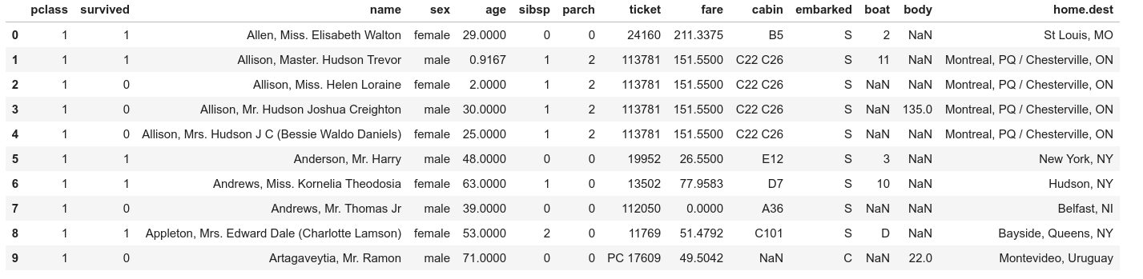
Get Data
Machine Learning Terminology
Header
Rows/ Examples/
Instances
Index
Features/Attributes/Dimensions

Slide 25
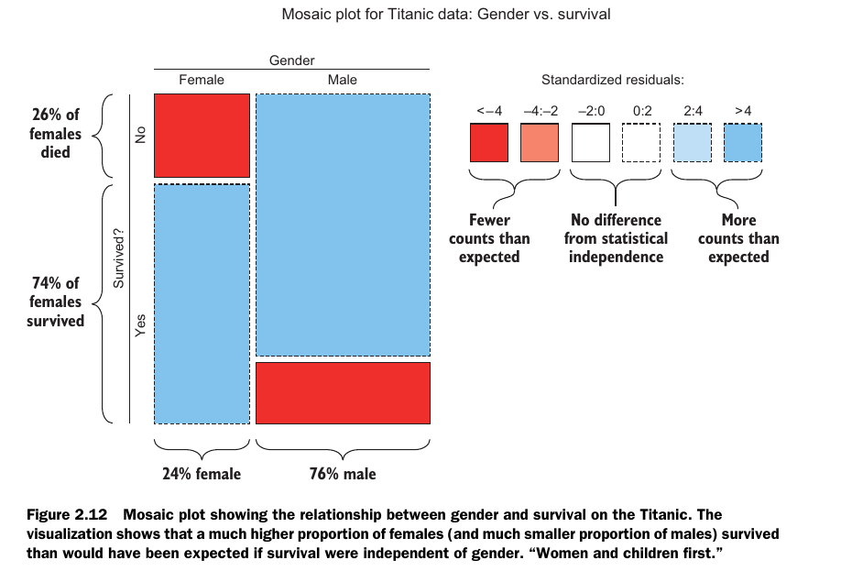
How to make sense of your data
You can visualize your data
mosaic plot
...

Slide 26
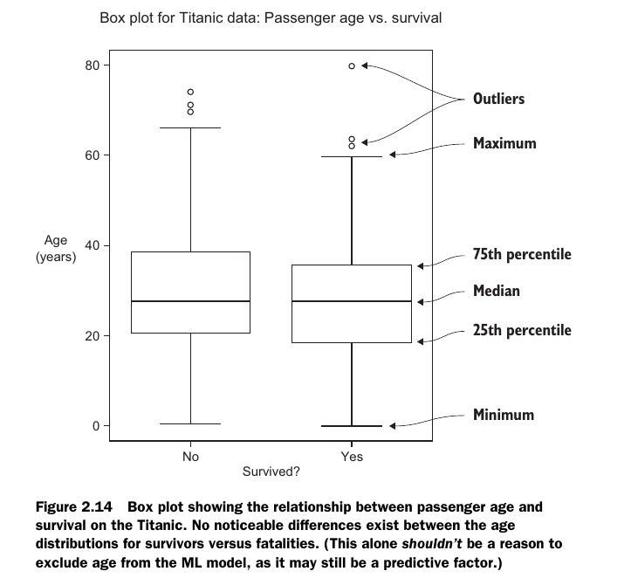
How to make sense of your data
You can visualize your data
Mosaic plot
Box plot
...

Slide 27
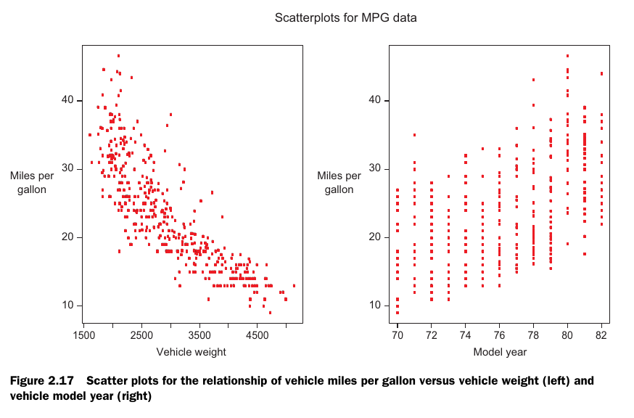
How to make sense of your data
You can visualize your data
Mosaic plot
Box plot
Density plot
Scatter plot (matrix)
...

Slide 28
Clean and Prepare Data

Slide 29
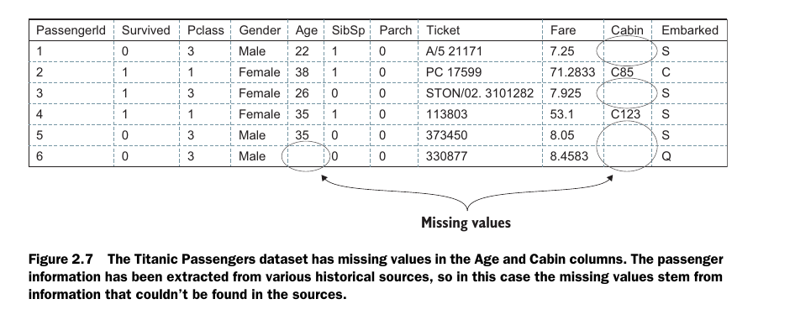
Clean and Prepare Data

Slide 30
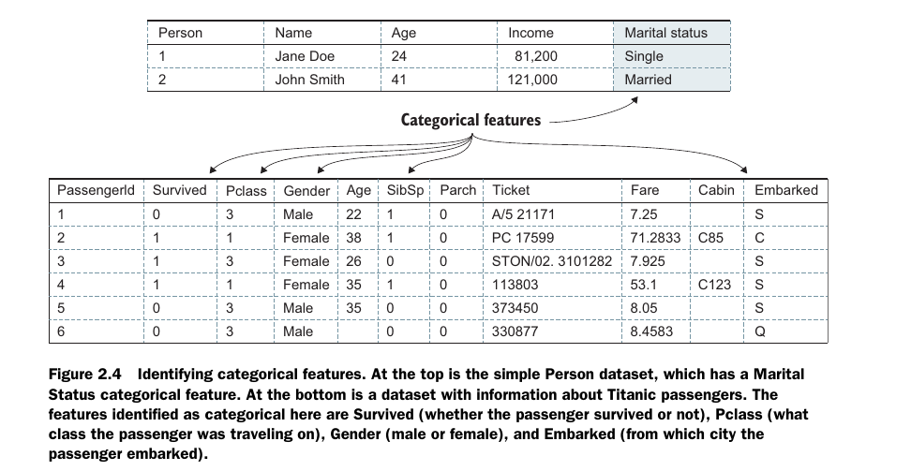
Clean and Prepare Data

Slide 31
Clean and Prepare Data

Slide 32
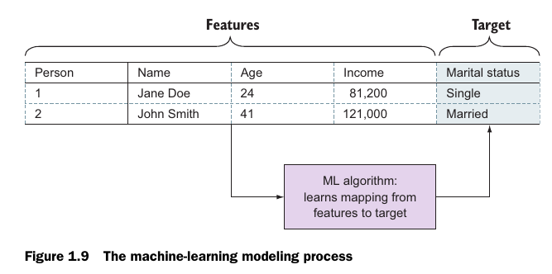
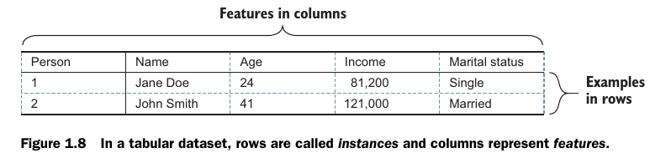
Train Model
But what algorithm?

Slide 33
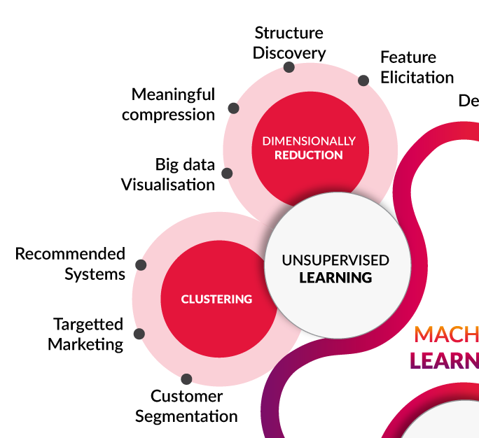
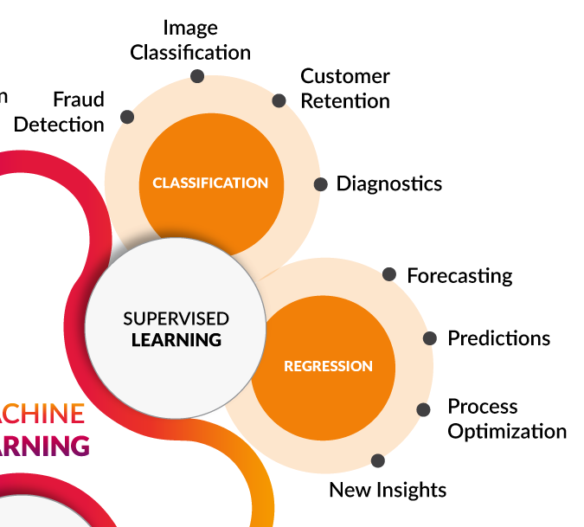

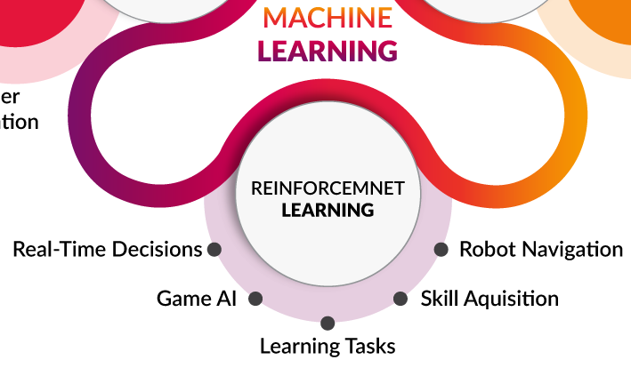
The landscape of Machine Learning
Source: Towards Data Science
Read further: https://litslink.com/blog/an-introduction-to-machine-learning-algorithms

Slide 34
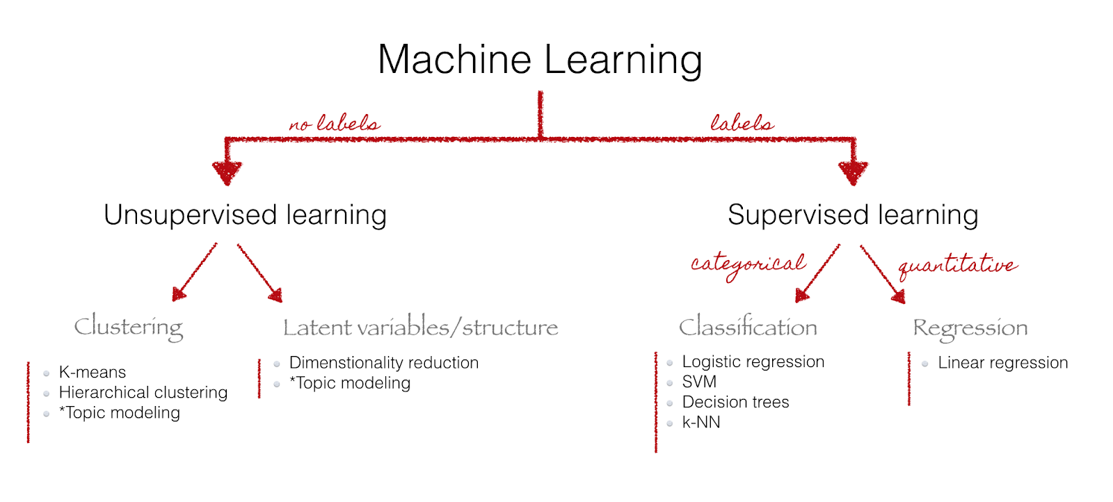
The landscape of Machine Learning
Common algorithms

Slide 35
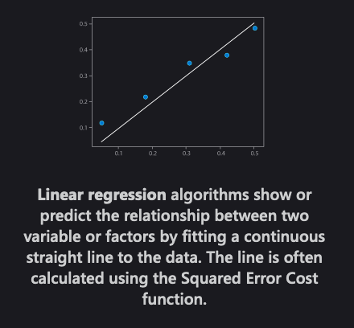

Linear regression
Regression model
We have a collection of labeled examples ${\left\{\left(x_{i}, y_{i}\right)\right\}}_{i=1}^{N},$where $N$ is the size of the collection, $x_{i}$is the $D$-dimensional feature vector of example $i=1,…,N$, $y_{i}$ is a real-valued target and every feature $x_{i}^{(j)}, j=1,…,D$, is also a real number.
We want to build a model $f_{w,b}\left(x\right)$as a linear combination of features of example $x:$ $f_{w,b}\left(x\right)=wx+b$ where $w$ is a $D$-dimensional vector of parameters and $b$ is a real number.
We will use the model to predict the unknown $y$ for a given $x$ like this: $y \overset{←}{} f_{w,b}(x)$. We want to find the optiomal values ($w^{∗}, b^{∗})$.
The objective function we want to minimize is $\frac{1}{N}\sum_{i=1}^{N}{{\left(f_{w,b}\left(x_{i}\right)−y_{i}\right)}^{2} (squared error loss).}$

Slide 36
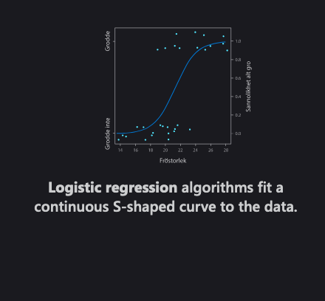

Logistic regression
Classification model
In logistic regression, we still want to model $y_{i}$ as a linear function of $x_{i}$, however, with a binary $y_{i}$, this is not straightforward.
If we define the negative label as 0 and the positive label as 1, we would just need to find a simple continuous function whose codomain is (0,1).
One function that has such a property is the standard logistic function (also known as sigmoid): $f\left(x\right)=\frac{1}{1+e^{−x}}$
The logistic regression model looks like this $f_{w,b}\left(x\right)=\frac{1}{1+e^{−\left(wx+b\right)}}.$
If we optimize the values of $w$ and $b$ appropriately, we could interpret the output of $f\left(x\right)$ as the probability of $y_{i}$ being positive.
The objective function in logistic regression is the likelihood of our training set according to the model: $L_{w,b}=\prod_{i=1…N}{f_{w,b}{\left(x_{i}\right)}^{y_{i}}}{\left(1−f_{w,b}\left(x_{i}\right)\right)}^{1−y_{i}} (assumes iid)$

Slide 37
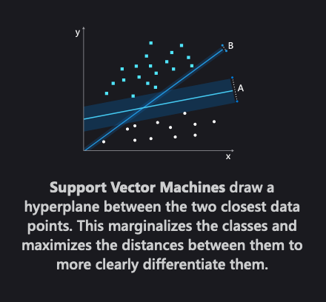
Support Vector Machine
Classification

Slide 38
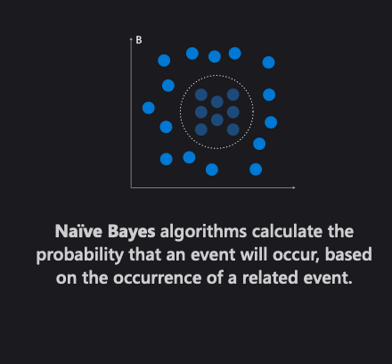

Naïve Bayers
Classification
Naïve Bayes is a conditional probability model: given a problem instance to be classified, represented by a vector $x=\left(x_{1},…,x_{n}\right)$ representing some $n$ features (independent variables), it assigns to this instance probabilities $p\left(C_{k} | x_{1},…,x_{n}\right)$ for each of $K$ possible outcomes or classes $C_{k}$.
The problem with the above formulation is that if the number of features $n$ is large or if a feature can take on a large number of values, then basing such a model on probability tables is infeasible. Using Bayes' theorem, the conditional probability can be decomposed as $p\left(C_{k}\right|x)=\frac{p\left(x | C_{k}\right)p\left(C_{k}\right)}{p\left(x\right)}$
In plain English, using Bayesian probability terminology, the above equation can be written as $posterior=\frac{likelihood x prior}{evidence}$
Now the "naïve" conditional independence assumptions come into play: assume that all features in $x$ are mutually independent, conditional on the category $C_{k}$. Under this assumption $p\left(C_{k} | x\right)∝p\left(C_{k}\right)\prod_{i=1}^{N}{p\left(x_{i} | C_{k}\right)}$
A Bayes classifier assigns a class label $\hat{y}=C_{k}$ as follows: $\hat{y}=\begin{matrix}argmax \\ k ∈\{1,…,K\}\end{matrix} p\left(C_{k}\right)\prod_{i=1}^{N}{p\left(x_{i} | C_{k}\right)}$

Slide 39
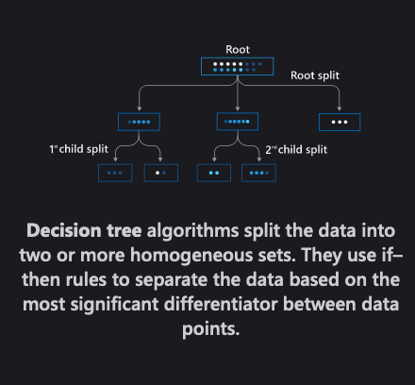
Decision tree
Classification

Slide 40
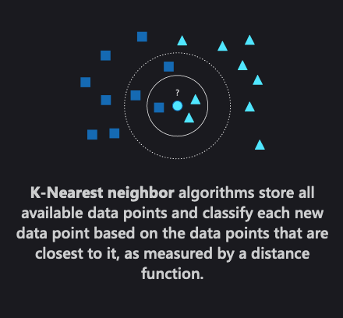
K-Nearest neighbor
Classification/Regression

Slide 41
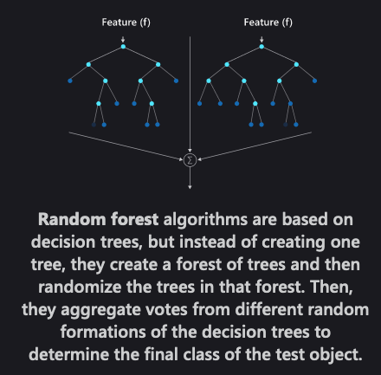
Random forest
Classification/Regression

Slide 42
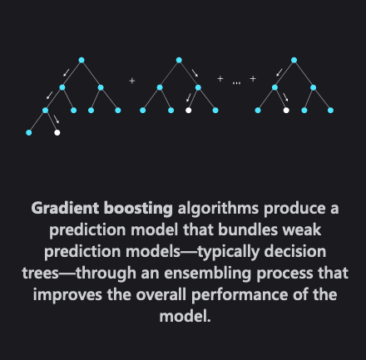
Gradient boosting
Classification/Regression

Slide 43
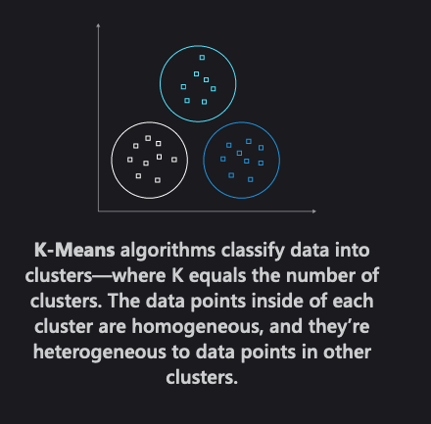
K-Means
Clustering

Slide 44
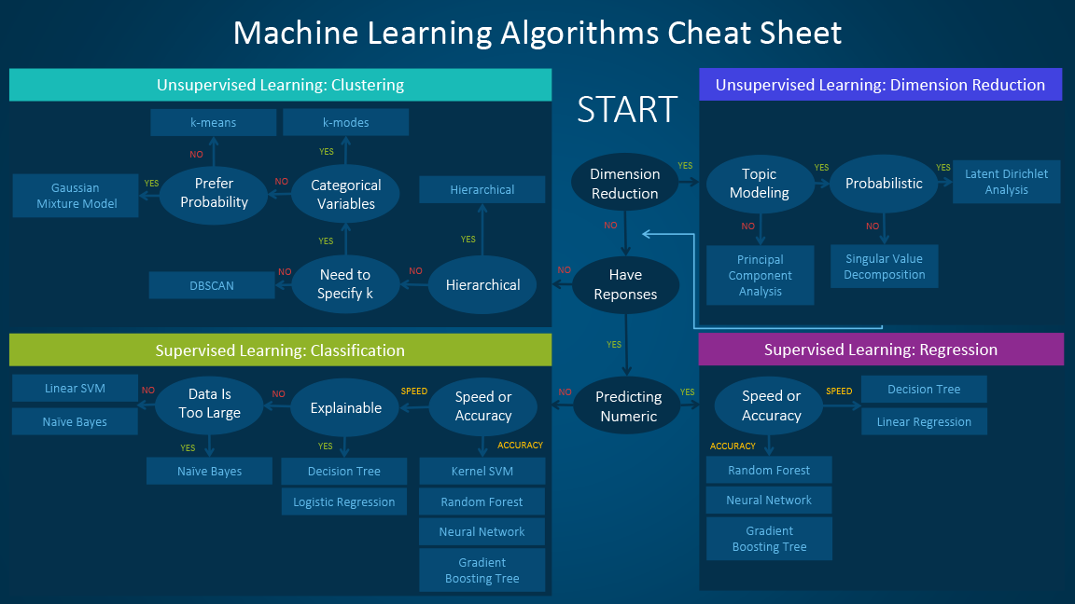
https://blogs.sas.com/content/subconsciousmusings/2017/04/12/machine-learning-algorithm-use/

Slide 45
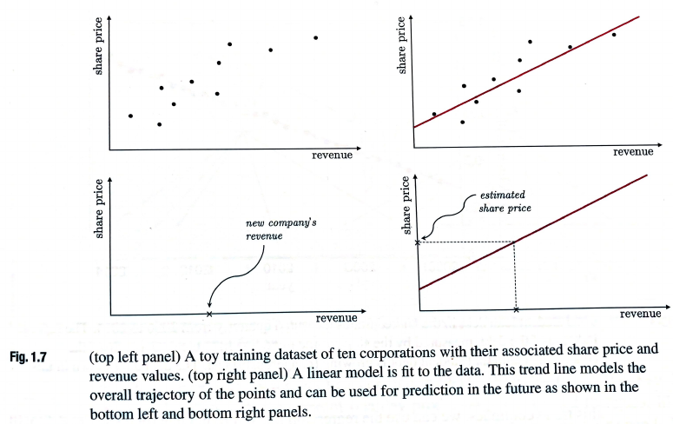
Classification vs Regression
Regression
Model data –
fitting curve

Slide 46
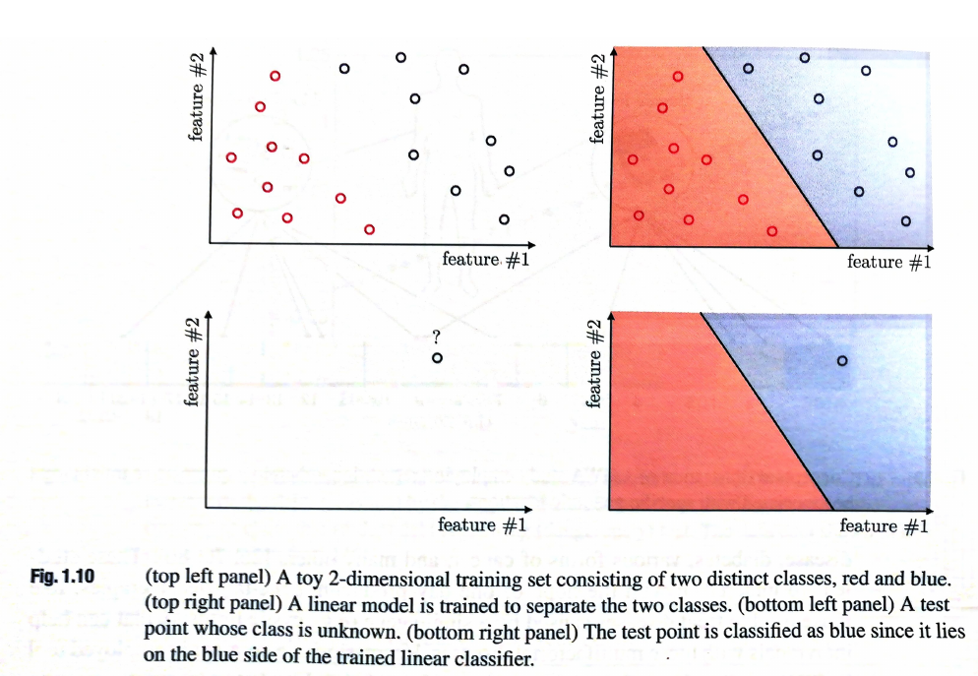
Classification vs Regression
Classification
Divide data –
Decision plane

Slide 47
Test Data

Slide 48
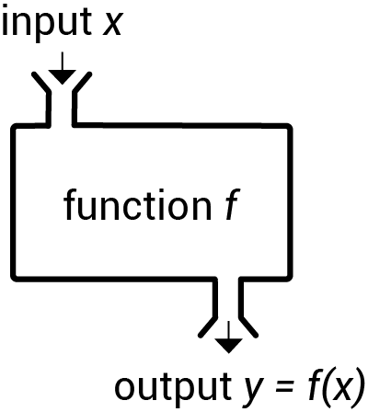
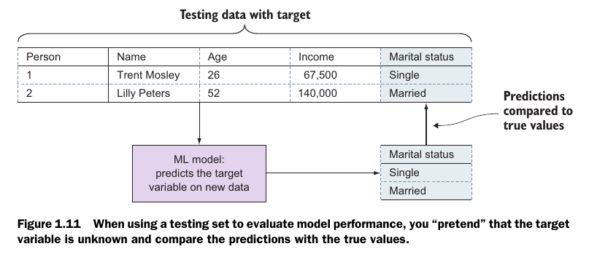
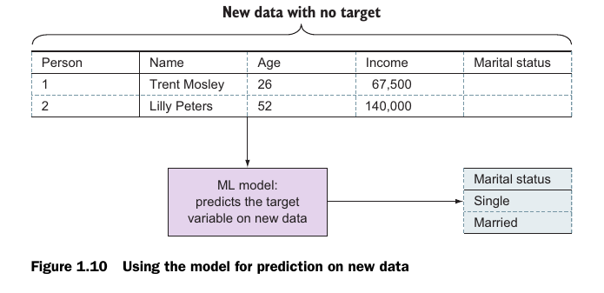
Test Data

Slide 49
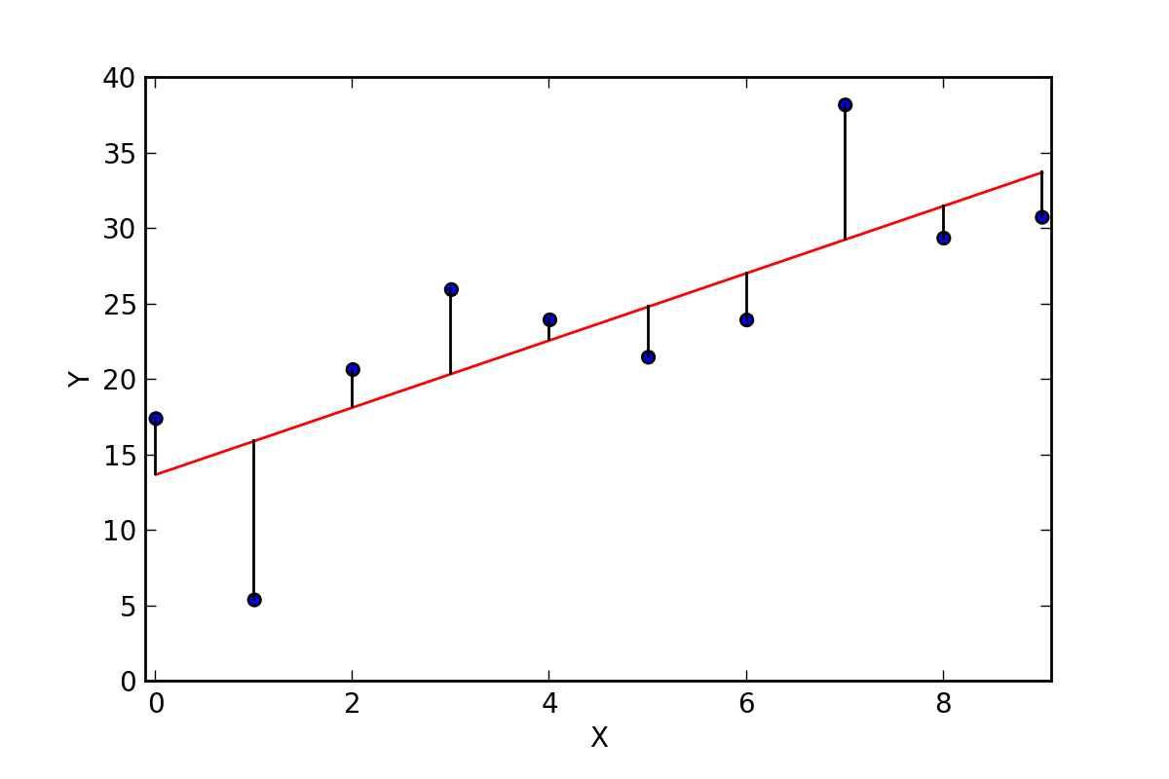
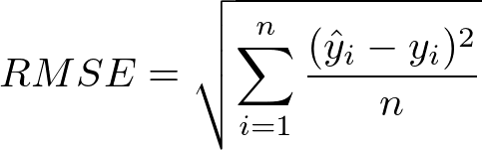
How do we measure our model’s performance?
Regression
(root) mean square error
learned model
prediction
error
observation
Mean deviation

Slide 50
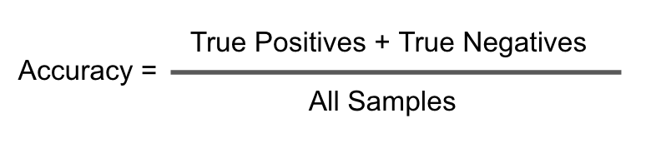
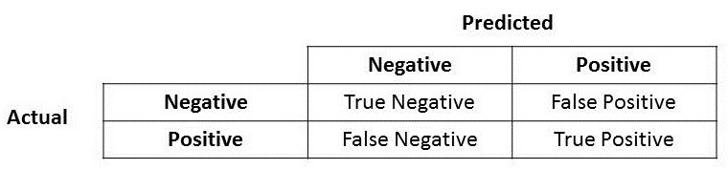
How do we measure our model’s performance?
Classification
(root) mean square error
confusion matrix
Percentage of correct predictions

Slide 51

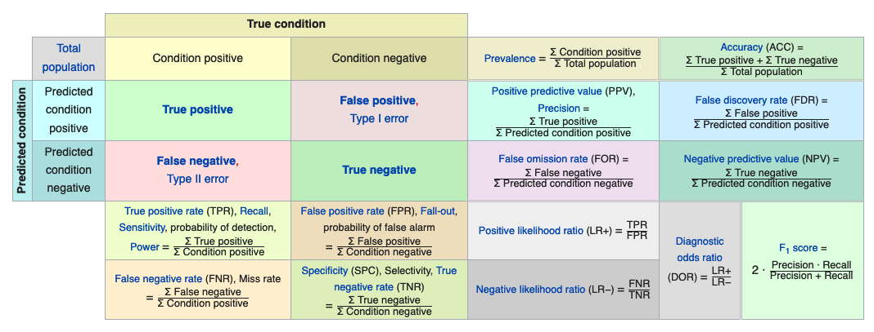
Beyond accuracy
This Photo by Unknown Author is licensed under CC BY-SA-NC

Slide 52
Improve Model

Slide 53
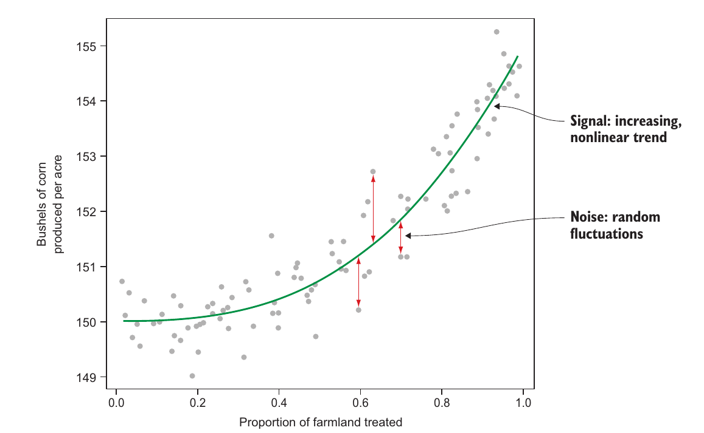
Real world data
signal-to-noise ratio

Slide 54
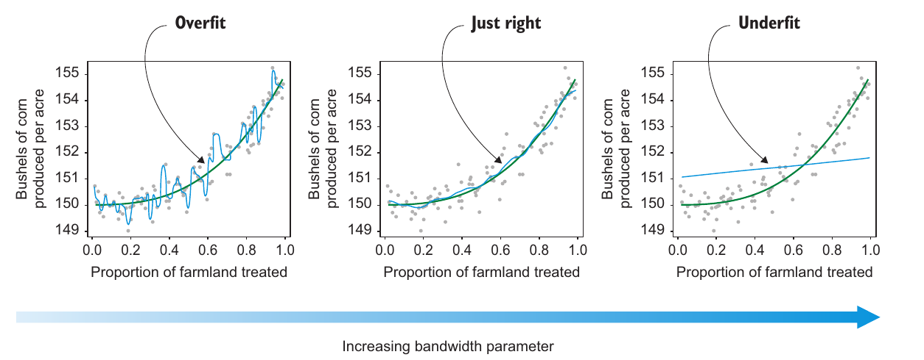


What makes a good model?
It may happen that the models we build are underfitted or overfitted

Slide 55
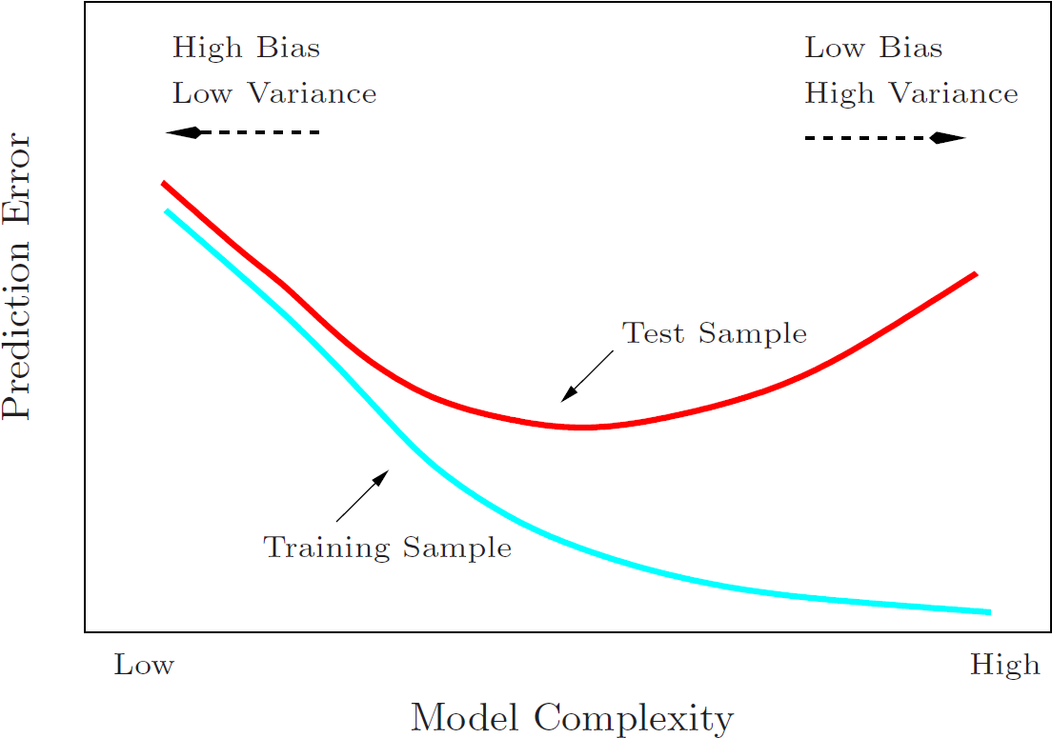
How do we measure our model’s performance?
When we have a performance measure, we can compare different models and their complexity
Underfitting
Too simple
Overfitting
Too complex

Slide 56
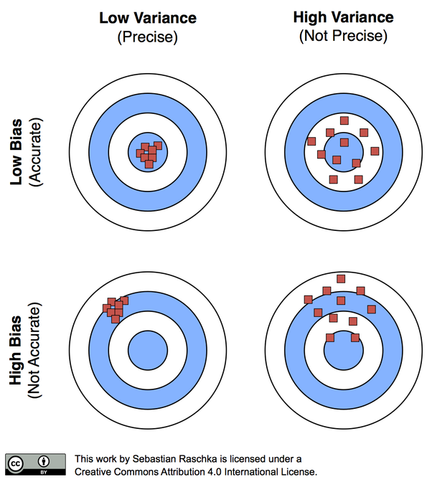
How do we measure our model’s performance?
Variance-Bias Trade-off

Slide 57

What about small data sets?
Cross-validation

Slide 58

What about large data sets?
Curse of dimensionality

Slide 59
Practice

Slide 60

Why Python
Source: Stack Overflow
https://medium.com/@UdacityINDIA/why-use-python-for-machine-learning-e4b0b4457a77

Slide 61

Python ecosystem

Slide 62

Python learning path

Slide 63
Packages, Packages everywhere !
Want to work with images — numpy, opencv, scikit
Want to work in text — nltk, numpy, scikit
Want to work in audio — librosa
Want to solve machine learning problem — pandas, scikit
Want to see the data clearly — matplotlib, seaborn, scikit
Want to use deep learning — tensorflow, pytorch
Want to do scientific computing — scipy
Want to integrate web applications — Django
Want to take a shower …. Well

Slide 64

Machine Learning Landscape
Python ecosystem
https://hackernoon.com/top-8-python-libraries-for-machine-learning-and-artificial-intelligence-y08id3031

Slide 65

Cheat Sheets

Slide 66

Numpy Cheat Sheet

Slide 67

Pandas Cheat Sheet

Slide 68

Matplotlib Cheat Sheet

Slide 69

Sscikit-Learn Cheat Sheet

Slide 70
Scikit-learn Design
https://arxiv.org/abs/1309.0238
Scikit-Learn’s API is remarkably well designed. These are the main design principles:
Consistency: All objects share a consistent and simple interface:
Estimators Any object that can estimate some parameters based on a dataset is called an estimator (e.g., an imputer is an estimator). The estimation itself is performed by the fit() method, and it takes only a dataset as a parameter (or two for supervised learning algorithms; the second dataset contains the labels). Any other parameter needed to guide the estimation process is considered a hyperparameter (such as an imputer’s strategy), and it must be set as an instance variable (generally via a constructor parameter).
Transformers Some estimators (such as an imputer) can also transform a dataset; these are called transformers. Once again, the API is simple: the transformation is performed by the transform() method with the dataset to transform as a parameter. It returns the transformed dataset. This transformation generally relies on the learned parameters, as is the case for an imputer. All transformers also have a convenience method called fit_transform() that is equivalent to calling fit() and then transform() (but sometimes fit_transform() is optimized and runs much faster).
Predictors Finally, some estimators, given a dataset, are capable of making predictions; they are called predictors. For example, the LinearRegression model in the previous chapter was a predictor: given a country’s GDP per capita, it predicted life satisfaction. A predictor has a predict() method that takes a dataset of new instances and returns a dataset of corresponding predictions. It also has a score() method that measures the quality of the predictions, given a test set (and the corresponding labels, in the case of supervised learning algorithms).¹⁸
Inspection: All the estimator’s hyperparameters are accessible directly via public instance variables (e.g., imputer.strategy), and all the estimator’s learned parameters are accessible via public instance variables with an underscore suffix (e.g., imputer.statistics_).
Nonproliferation of classes Datasets are represented as NumPy arrays or SciPy sparse matrices, instead of homemade classes. Hyperparameters are just regular Python strings or numbers.
Composition Existing building blocks are reused as much as possible. For example, it is easy to create a Pipeline estimator from an arbitrary sequence of transformers followed by a final estimator, as we will see.
Sensible defaults Scikit-Learn provides reasonable default values for most parameters, making it easy to quickly create a baseline working system.

Slide 71
Where to go from here
Learn the language
Learn the tools
Work on projects!
Resources
Machine Learning Mastery
Hands-On Machine Learning with Scikit-Learn and TensorFlow
The Complete Python Course for Machine Learning Engineers
Cheat Sheet of Machine Learning and Python (and Math) Cheat Sheets

Slide 72
Questions
Hands-On Machine Learning with Scikit-Learn, Keras, and TensorFlow, 2nd Edition by Aurélien Géron, Publisher: O'Reilly Media, Inc. Release Date: September 201
How would you define Machine Learning?
Can you name four types of problems where it shines?
What is a labeled training set?
What are the two most common supervised tasks?
Can you name four common unsupervised tasks?
What type of Machine Learning algorithm would you use to allow a robot to walk in various unknown terrains?
What type of algorithm would you use to segment your customers into multiple groups?
Would you frame the problem of spam detection as a supervised learning problem or an unsupervised learning problem?
What is an online learning system?
What is out-of-core learning?
What type of learning algorithm relies on a similarity measure to make predictions?
What is the difference between a model parameter and a learning algorithm’s hyperparameter?
What do model-based learning algorithms search for? What is the most common strategy they use to succeed? How do they make predictions?
Can you name four of the main challenges in Machine Learning?
If your model performs great on the training data but generalizes poorly to new instances, what is happening? Can you name three possible solutions?
What is a test set, and why would you want to use it?
What is the purpose of a validation set?
What is the train-dev set, when do you need it, and how do you use it?
What can go wrong if you tune hyperparameters using the test set?

Slide 73
Answers
Machine Learning is about building systems that can learn from data. Learning means getting better at some task, given some performance measure.
Machine Learning is great for complex problems for which we have no algorithmic solution, to replace long lists of hand-tuned rules, to build systems that adapt to fluctuating environments, and finally to help humans learn (e.g., data mining).
A labeled training set is a training set that contains the desired solution (a.k.a. a label) for each instance.
The two most common supervised tasks are regression and classification.
Common unsupervised tasks include clustering, visualization, dimensionality reduction, and association rule learning.
Reinforcement Learning is likely to perform best if we want a robot to learn to walk in various unknown terrains, since this is typically the type of problem that Reinforcement Learning tackles. It might be possible to express the problem as a supervised or semisupervised learning problem, but it would be less natural.
If you don’t know how to define the groups, then you can use a clustering algorithm (unsupervised learning) to segment your customers into clusters of similar customers. However, if you know what groups you would like to have, then you can feed many examples of each group to a classification algorithm (supervised learning), and it will classify all your customers into these groups.
Spam detection is a typical supervised learning problem: the algorithm is fed many emails along with their labels (spam or not spam).
An online learning system can learn incrementally, as opposed to a batch learning system. This makes it capable of adapting rapidly to both changing data and autonomous systems, and of training on very large quantities of data.
Out-of-core algorithms can handle vast quantities of data that cannot fit in a computer’s main memory. An out-of-core learning algorithm chops the data into mini-batches and uses online learning techniques to learn from these mini-batches.
An instance-based learning system learns the training data by heart; then, when given a new instance, it uses a similarity measure to find the most similar learned instances and uses them to make predictions.
A model has one or more model parameters that determine what it will predict given a new instance (e.g., the slope of a linear model). A learning algorithm tries to find optimal values for these parameters such that the model generalizes well to new instances. A hyperparameter is a parameter of the learning algorithm itself, not of the model (e.g., the amount of regularization to apply).
Model-based learning algorithms search for an optimal value for the model parameters such that the model will generalize well to new instances. We usually train such systems by minimizing a cost function that measures how bad the system is at making predictions on the training data, plus a penalty for model complexity if the model is regularized. To make predictions, we feed the new instance’s features into the model’s prediction function, using the parameter values found by the learning algorithm.
Some of the main challenges in Machine Learning are the lack of data, poor data quality, nonrepresentative data, uninformative features, excessively simple models that underfit the training data, and excessively complex models that overfit the data.
If a model performs great on the training data but generalizes poorly to new instances, the model is likely overfitting the training data (or we got extremely lucky on the training data). Possible solutions to overfitting are getting more data, simplifying the model (selecting a simpler algorithm, reducing the number of parameters or features used, or regularizing the model), or reducing the noise in the training data.
A test set is used to estimate the generalization error that a model will make on new instances, before the model is launched in production.
A validation set is used to compare models. It makes it possible to select the best model and tune the hyperparameters.
The train-dev set is used when there is a risk of mismatch between the training data and the data used in the validation and test datasets (which should always be as close as possible to the data used once the model is in production). The train-dev set is a part of the training set that’s held out (the model is not trained on it). The model is trained on the rest of the training set, and evaluated on both the train-dev set and the validation set. If the model performs well on the training set but not on the train-dev set, then the model is likely overfitting the training set. If it performs well on both the training set and the train-dev set, but not on the validation set, then there is probably a significant data mismatch between the training data and the validation + test data, and you should try to improve the training data to make it look more like the validation + test data.
If you tune hyperparameters using the test set, you risk overfitting the test set, and the generalization error you measure will be optimistic (you may launch a model that performs worse than you expect).

Slide 75

Kontakt
Michael Aydinbas
Data Scientist
@ michael.aydinbas@EXXETA.com
m +49 174 99 50 913

